Slide 1
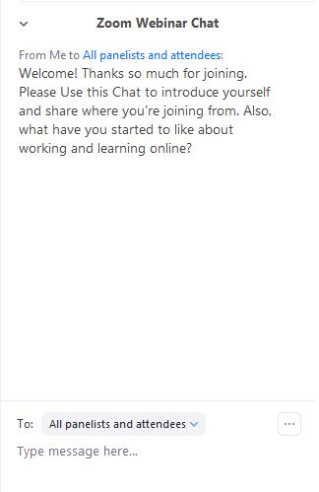
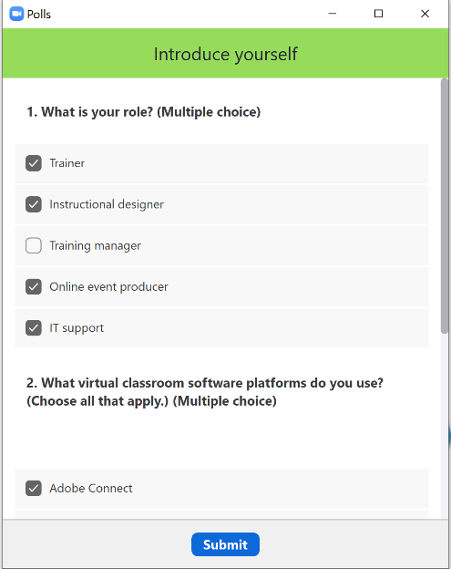
In Zoom (Windows), tools look like this.
Raise hand to indicate “yes” and to ask permission to respond verbally.
Chat for open-ended questions with many possible answers.
Non-verbal feedback Yes or No (Binary poll)
Polls for quiz-style questions when there is one or more RIGHT answers.
Notes:
Provide a place for them to respond.
Be sure to tell learners how to respond.

Slide 2
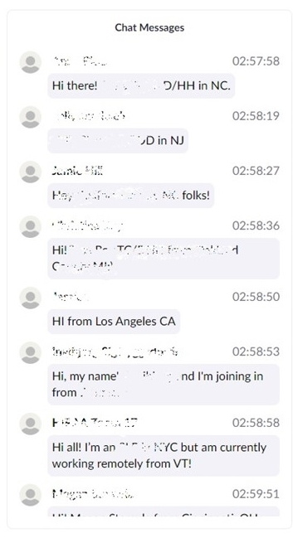
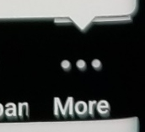
In Zoom (App), tools look like this.
Chat for open-ended questions with many possible answers.
Use the More menu (lower right corner) to click Raise hand.
Polls for quiz-style questions when there is one or more RIGHT answers.
Set Status to Clap or Thumbs up
Notes:
Provide a place for them to respond.
Be sure to tell learners how to respond.

Slide 3
Ground rules for participation
Please resist distractions
Ask questions and contribute to the discussion by typing in Chat
Agree to participate…

Slide 4
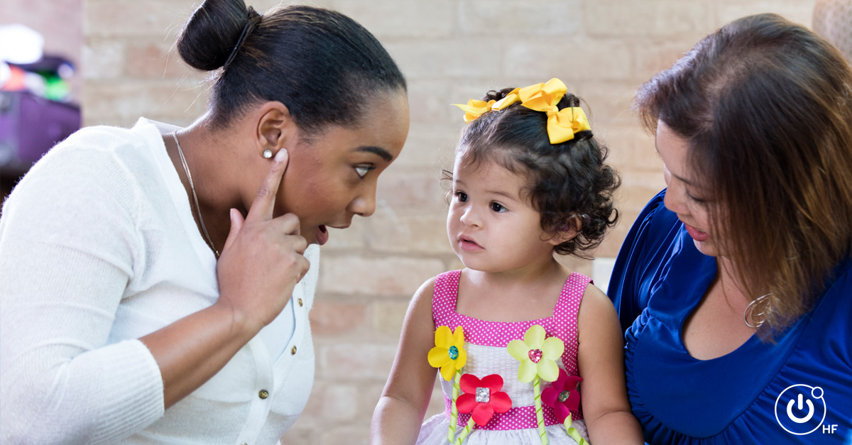
115: Leveraging Adobe Connect for Successful Blended Learning: A Case Study
In this session you'll learn:
The basics of a flipped-classroom design and delivery model
How to determine the roles of key team members
Production and preparation and planning steps
Technical considerations
Three we wish had known before we started
Notes:
In 2016, Hearing First had a goal to connect subject matter experts with hearing professionals and parents to help them develop skills and knowledge to better support children who are deaf or hard of hearing. We've been successfully meeting this need for nearly three years, but getting there wasn't easy.
In this session you'll learn how we went about meeting the challenge and adopted an evidence-based, flipped classroom model (or blended learning model) to improve learner outcomes. You'll learn how we leveraged an online community platform for independent learning assignments, recordings, and resources, and facilitated virtual classroom sessions to engage with others and apply new skills. We'll also share the failures and the genius of our design and production plans, insights into the software tools we use, and methods we use to prepare and motivate subject matter experts and participants.

Slide 5
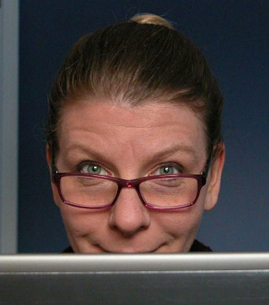
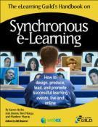
Karen Hyder, CTT+
karen@karenhyder.com
www.linkedin.com/in/karenhyder
Twitter @karenhyder
English language teacher | ‘88-‘93
Application software trainer | ‘91-‘96
Classroom train-the-trainer trainer | ‘95-‘99
Online train-the-trainer course designer and trainer | ’99-‘18
Adviser for CompTIA’s Certified Technical Trainer CTT+ | ‘01-‘17
Online event producer, coach, trainer | ‘99-‘18
Producer for The eLearning Guild Online Forums http://bit.ly/XCQVKJ | ‘03-‘15
The eLearning Guild Spotlight and Showcase events http://bit.ly/2bRhc9J | ‘09-‘18
Co-wrote The eLG’s Handbook on Synchronous e-Learning http://bit.ly/Y6Z760 | ‘07
CompTIA’s Certified Technical Trainer CTT+ VCT certification http://bit.ly/kNXwIa | ‘08
Guild Academy Virtual classroom courses | ‘13-‘15
Mute your Mic Blog post https://bit.ly/2WVb2vr | ‘14-’17
CompTIA’s CTT+ 8-week Deep Dive https://app.box.com/v/DeepDiveCTTplus | ’16
The eLearning Guild’s Guild Master | ‘17
Director of Online Events – Hearing First | ‘17-pres.
Notes:
As you know, I’m Karen Hyder. I’m your trainer and host for this virtual classroom program. My background is in training. In one form or another, it’s what I’ve always done. I started out as an English teacher for non-native, adult students and later became a computer software trainer and then taught others to be trainers. Then, I developed a course to teach people to teach online using a tool called Placeware, which later became Microsoft Live Meeting.
I was instrumental in creating a certification for online trainers through CompTIA. Their 12 competencies provide a benchmark for good training online or in a face-to-face classroom.
What I’ve done is distilled what I’ve learned through all of these experiences to teach you and guide you as you adopt these new tools. It’s possible that I’ll ask you to do things that sound strange. I’m going to ask you to play along.

Slide 6
Goal: Teach a global audience of professionals and parents
who help children who are deaf or hard of hearing
get the services and support they need
to learn to listen and speak
where ever they are
in the world.
© Hearing First, LLC. ALL RIGHTS RESERVED.
Istock.com
Notes:
https://www.istockphoto.com/vector/earth-listen-gm119114783-13384679

Slide 7
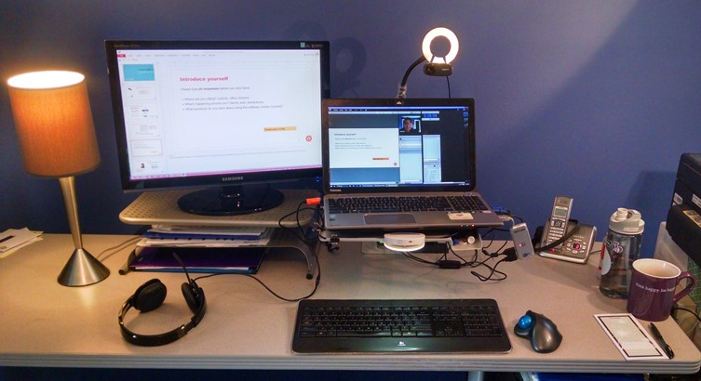
Learning experiences had to become scalable and locally available.
All online.
© Karen Hyder

Slide 8
What types of interactions are possible…
In live online sessions with other participants and a facilitator?
Type in Chat
In self-paced, asynchronous learning?
Type in Chat

Slide 9
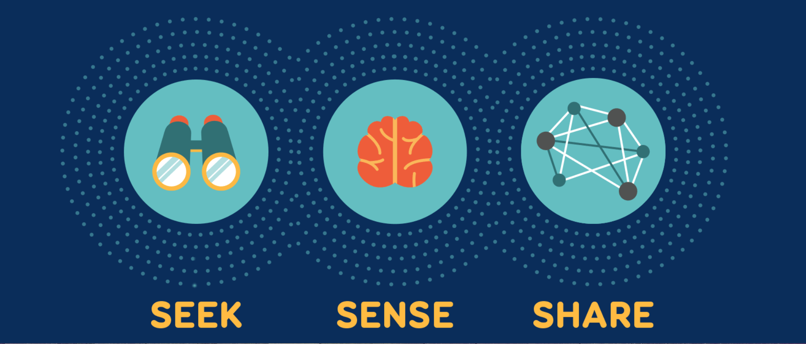
SEEK SENSE SHARE
Seeking is how we discover new information and keep up to date. Building a network of colleagues is key. Not only does this allow us to pull information, it also creates a way to have information pushed to us by trusted sources.
Sensing is how we personalize and use information. Sensing includes reflection and putting into practice what we’ve learned. It often requires experimentation, as we learn best by doing.
Sharing how we exchange resources, ideas and experiences with our networks, as well as collaborate with our colleagues.
Source: Harold Jarche’s “Seek, Sense, Share”; Creative Commons BY-NC 2012; Jarche.com
For more information, read the HF blog post https://hearingfirst.org/blog/2016/04/19/seek-sense-share
© Hearing First, LLC. ALL RIGHTS RESERVED.
Notes:
http://theelearningcoach.com/media/graphics/use-visual-cues-to-enhance-learning/
The first step to personal knowledge mastery is the Seek-Sense-Share learning model. It was created by Harold Jarche, connected learning specialist, and it’s a concept that Hearing First supports for learning through our personal and professional networks. This learning model helps us make that data meaningful by being productive in our work and in the world of LSL. So, how does Seek-Sense-Share work exactly?
Jarche defines the Seek-Sense-Share model like this:
SEEK
Seeking is how we discover new information and keep up to date. Building a network of colleagues is key. Not only does this allow us to pull information, it also creates a way to have information pushed to us by trusted sources.
SENSE
Sensing is how we personalize and use information. Sensing includes reflection and putting into practice what we’ve learned. It often requires experimentation, as we learn best by doing.
SHARE
Sharing is how we exchange resources, ideas and experiences with our networks, as well as collaborate with our colleagues.
Source: Harold Jarche’s “Seek, Sense, Share”; Creative Commons BY-NC 2012; Jarche.com

Slide 10
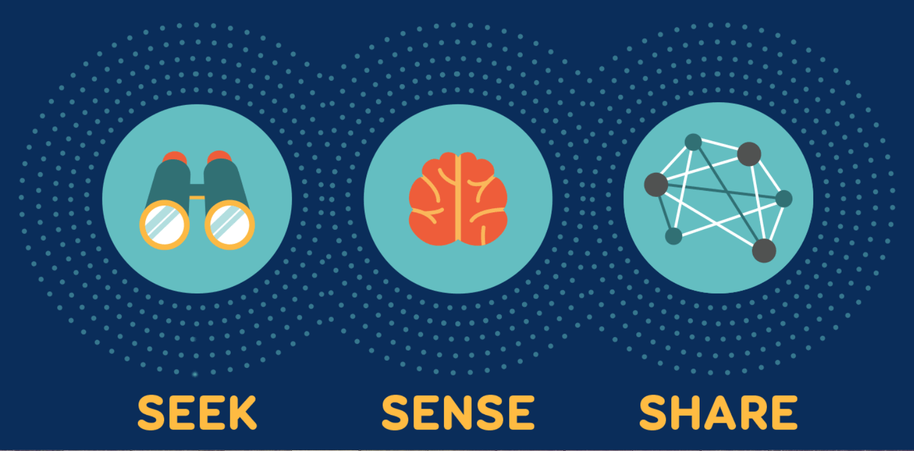
Hearing First
Comment on videos or readings in Community
Watch videos posted on the Community
Read articles
Report outcomes
Tell stories
Curate content
Work in groups
Observe a case study
Write a review
Source: Harold Jarche’s “Seek, Sense, Share”; Creative Commons BY-NC 2012; Jarche.com
Connect key learnings with real life situations.
© Hearing First, LLC. ALL RIGHTS RESERVED.
Notes:
Some activities work better in

Slide 11
Facilitator
Pre-learning
Live session
Source/develop content
Record or source video clips
Caption videos
Write/post introductory paragraphs
Write discussion questions
Manage local technology
Team with event producer
Learn to teach in new format
Develop PPT slides
Add engagement
Write questions
Between sessions
Read all posts
Comment on discussions
Respond to questions.

Slide 12
Team roles
Participant
Facilitator
Coach/Host/Producer
Captioner
Document and traffic manager
Content visionary/Instructional Design lead
IT support
Programmer
Registrar
Graphics
Communications/Marketing
Project manager
Fearless leader

Slide 13
Project and content management tools
Zoom
Goggle Docs
Drop box
Wistia
Team meetings
Small group sessions
Comms text
Archive content
Large file transfer
HIPPA- ssecure video storage
Teams/Outlook
Hubspot
Wrike
Scheduling and messaging
Attendance tracking and reporting. CEU documents.
Forecasting
Details
Project tasks/owners
Notes:
Flipped just reorders the delivery methods so that most of the prep work is done up front, before learners attend the live session. That way, everyone is better prepared to handle the application, the practice, the feedback activities that make sense to do live.
When everything needs to be done online and NOTHING can be done in person, the team is required to re-think every element of the design and delivery.

Slide 14
Delivery platforms
Telligent
Adobe Connect
Registration
File and Media Gallery
Content repository
Assignment tracking
Text messaging
Broadcast messaging
Bridge to live session login
Uploading
Seek & Sense
Share
Dig Deeper
Discussion forum threads
Live session
Breakout groups
Video clips
Voice over the internet (VoIP) audio and telephony
Webcams
Polls
Chat
Recording
Attendance tracking
Captioning https://captionfirst.com/
Find free and licensable apps https://www.adobe.com/products/adobeconnect/apps.html
Notes:
Flipped just reorders the delivery methods so that most of the prep work is done up front, before learners attend the live session. That way, everyone is better prepared to handle the application, the practice, the feedback activities that make sense to do live.
When everything needs to be done online and NOTHING can be done in person, the team is required to re-think every element of the design and delivery.

Slide 15
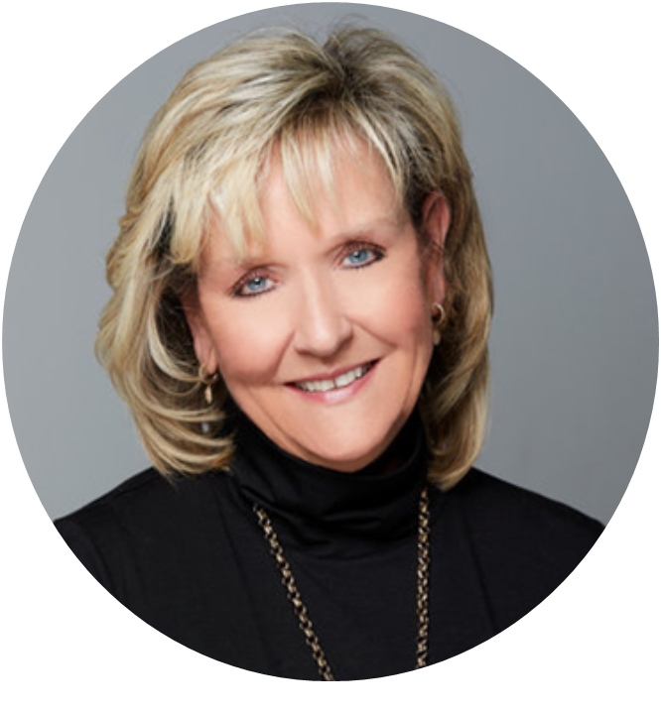
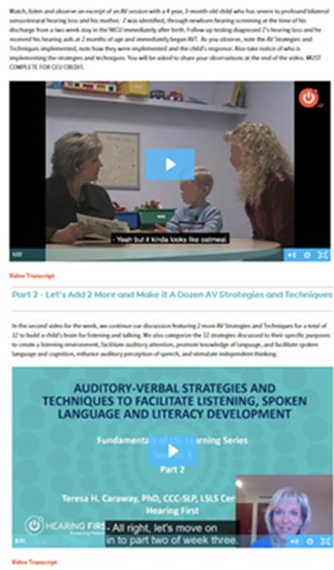
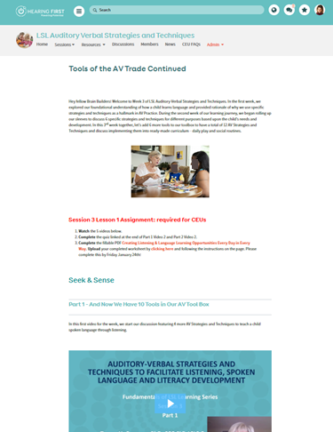
Intro text
Intro text
Embedded video
Photo
Transcript of video
Assignment Required for CEUs
Seek & Sense
Facilitator Lecture Part 2
Facilitator Lecture Part 1
Transcript of video
© Teresa Caraway and Hearing First, LLC. ALL RIGHTS RESERVED
Notes:
Sample content

Slide 16
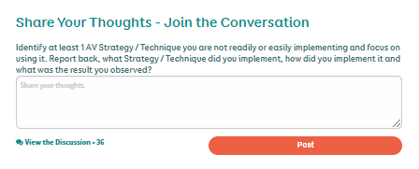
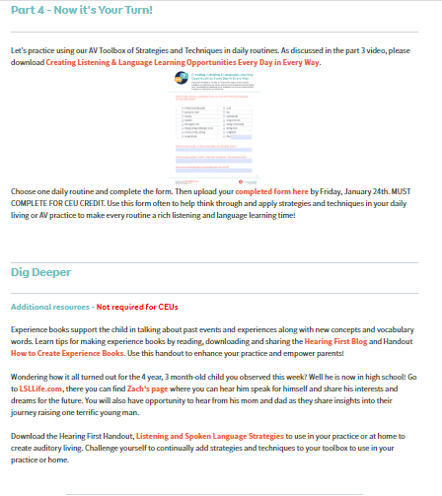
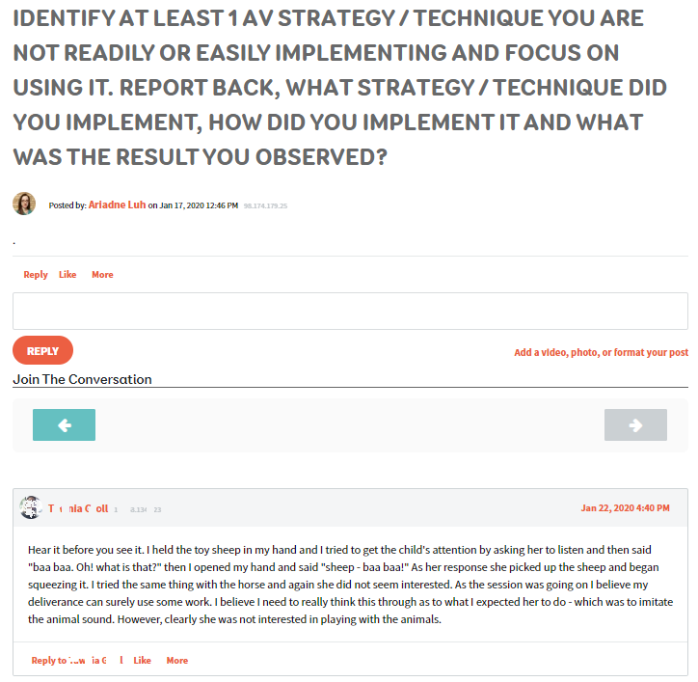
Downloadable Form
Discussion
Complete and upload form for CEUs
Additional resources
Post
© Teresa Caraway and Hearing First, LLC. ALL RIGHTS RESERVED
Notes:
Sample content

Slide 17
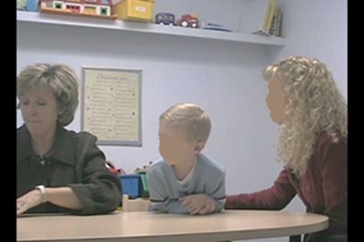
From Session 3 Quiz…
Child Video 1: Snow
“The child was engaged in the conversation. He added new information about the school sensory table (e.g., "feels like dry bread"). The extension of the topic allowed the child to demonstrate his independent thinking skills.
The therapist used strategy of create a listening environment. When the child was omitting the sound/s/ in the word snow, therapist used acoustic highlighting with prolongation of /s/. After child imitated it correctly she it put back into listening so that auditory loop is created.”
© Teresa Caraway and Hearing First, LLC. ALL RIGHTS RESERVED
Notes:
Sample content

Slide 18
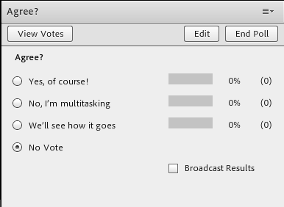
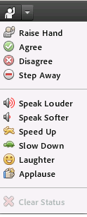
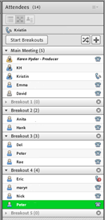
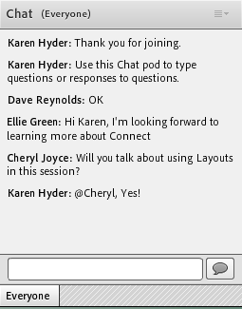
Interaction tools in Adobe Connect
Raise hand to indicate “yes” and to ask permission to respond verbally
Polls for quiz-style questions when there is one or more CORRECT answers
Connect audio and speak up for verbal responses to open-ended questions with long, unique answers
Set Status to Agree or Disagree (Binary poll), provide impromptu feedback, or indicate “away”
Breakout rooms separate participants into audio-video sub-groups to discuss and complete tasks
Chat for open-ended questions with many possible answers
Notes:
Pods and functions

Slide 19
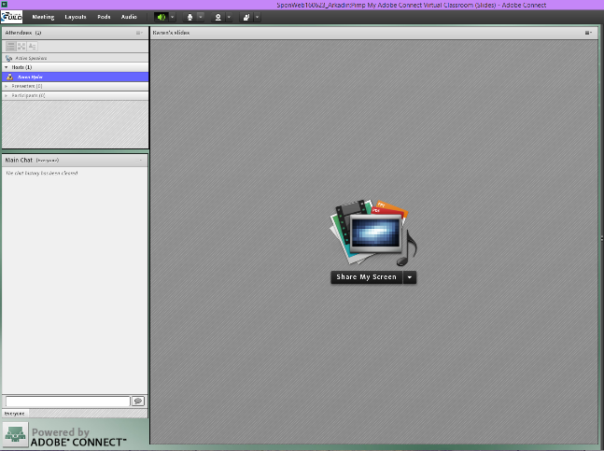
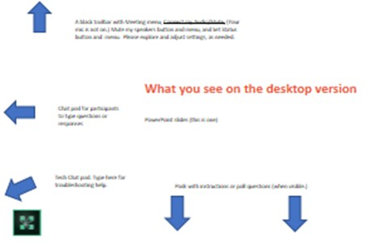
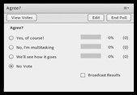
What participants see

Slide 20
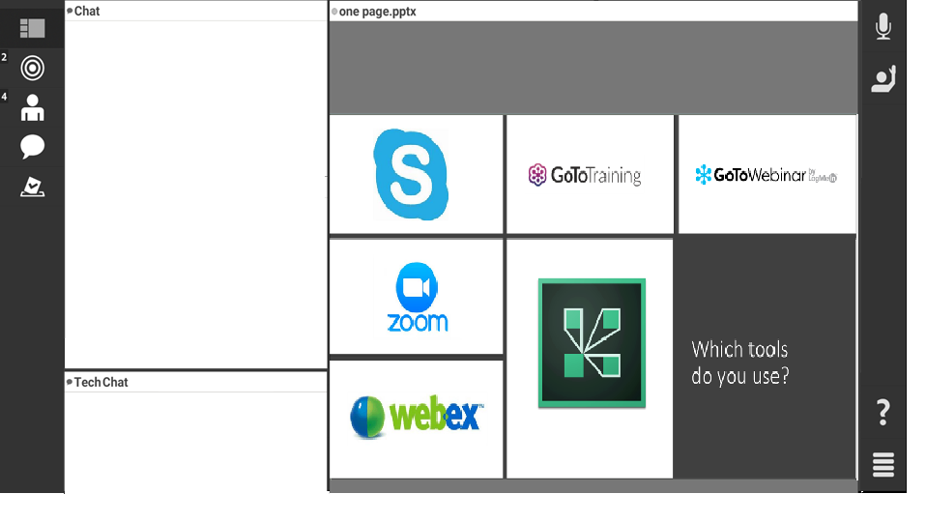
What participants see on the mobile app
Connect my Mic button, when available
“Normal” view button
Set status and Agree Disagree
Slides view
PPT slide file or shared application
Start private Chat with…
Select other pods
Switch to other Polls
Chat and Tech Chat pods
Notes:
The meeting room or your classroom is an online application that you use to conduct a meeting. The meeting room consists of various display panels or pods and components. At Hearing First, you will use Adobe connect to facilitate sessions for your Learning Experience.
Your Producer will help you set it up and will be standing by during live sessions to assist, as needed. Ask for help anytime.

Slide 21
Type questions and comments into Chat
Use the Pod Options menu to increase Font size and change the Text color of your messages.
You can also Start a Private Chat. Private Chat with Host for Technical support during the session.
Type in the white space here
Click Send or press Enter
Notes:
Notice the Chat pod. This operates like most text-based tools. There’s a white box at the bottom where you can type your message and press Enter or click the Send button. All participants will see what others typed unless they Private message.
We use Chat a lot, remember, participants are asked to Mute their own microphones when not talking, so they often type questions and comments here. We can promote this by asking open-ended questions and asking them to type in Chat—then WAIT! You must wait 34-45-60 seconds sometimes before you start seeing typed messages. You will see a little message at the very bottom of the Chat pod to alert you the people are indeed typing, It makes the waiting easier knowing something IS HAPPENING.
Do you see in the top right corner of the Chat pod there's a pod options menu? (Each pod on screen has a Pod options menu. The options are different depending on what pod you’re in.) Notice under Pod options there’s a way to change the text size
We’ve designed the session to be interactive, so it’s important that you participate by typing in Chat. This is how you type your question or response, and then click send or press enter.

Slide 22
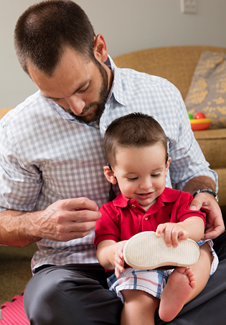
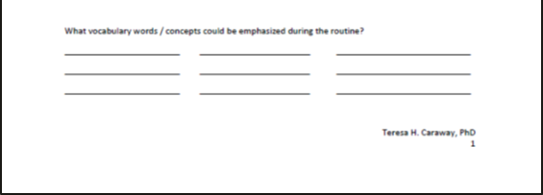
What vocabulary words / concepts could be emphasized?
Thinking about either a BABY, TODDLER, or PRESCHOOLER would be examples of age appropriate vocabulary words or and / or concepts that could be emphasized?
Choose an age group and share in CHAT
© Teresa Caraway and Hearing First, LLC. ALL RIGHTS RESERVED

Slide 23
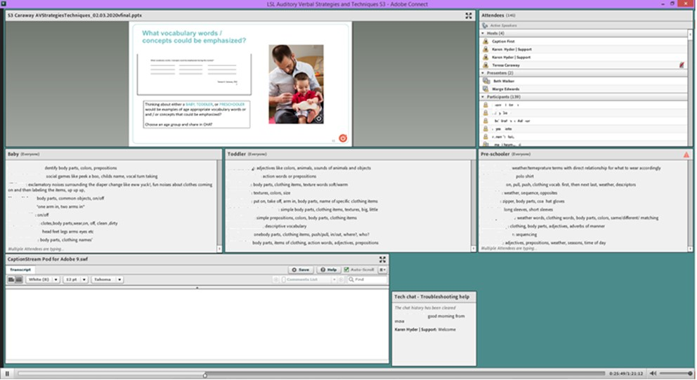
3-chat pod activity
© Teresa Caraway and Hearing First, LLC. ALL RIGHTS RESERVED

Slide 24
Questions
What questions might you ask in Chat?
Type in Chat
What poll questions might you include?
Type in Chat

Slide 25
Set Status to provide feedback
If you can hear me talking now, please change your status to Agree (Green check).
If you cannot hear me, change your Status to Disagree (Red X)
To show the Status menu, click the drop down arrow next to the Raise Hand button at the top of your screen.
Click Raise hand button to see Set status and Agree Disagree
Change your status to “Stepped Away” anytime you’re distracted from the session.
Notes:
If you don’t need a pre-planned poll but you do want to know if participants are, “ready to begin…” or “hearing you ok on audio” the Set Status menu is the best option.
So often you just need to know if people are with you or not. The producer will encourage the participants to begin using set status at the beginning of the session.
Please provide feedback anytime by changing your status. Do so by clicking on the drop down menu next to the raised hand button in the bar at the top of your screen.
Use Raise hand to indicate you want to speak up using your microphone.
Remember to show Stepped Away if you do need to use the restroom or take a call. It’s helpful to know that your name is there, but you aren’t there.

Slide 26
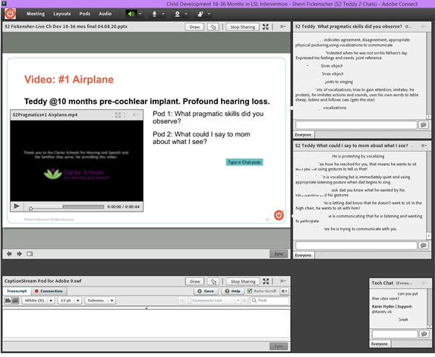
Sherri Fickenscher, M.S., LSLS Cert. AVEd Teacher of the Deaf Education Support Specialist Clarke Schools for Hearing & Speech
Notes:
Sherri Fickenscher, M.S., LSLS Cert. AVEd Teacher of the Deaf Education Support Specialist
Clarke Schools for Hearing & Speech

Slide 27
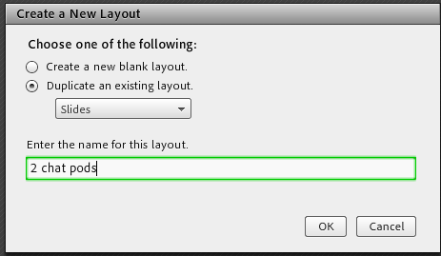
Pre-set activities using Layouts

Slide 28
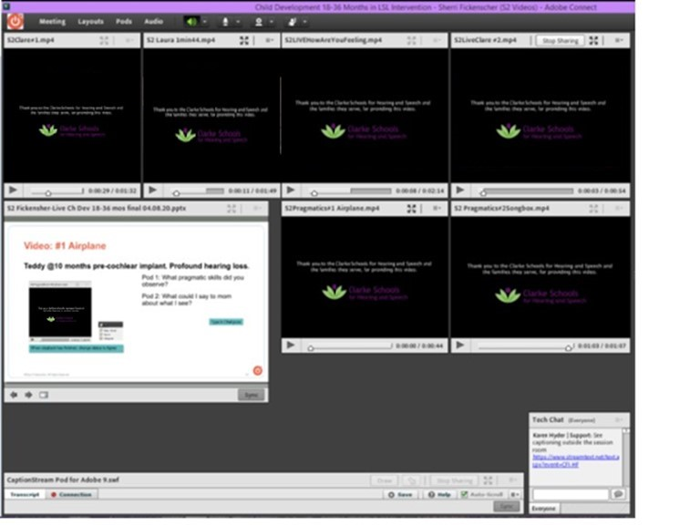
Video “inventory” layout

Slide 29
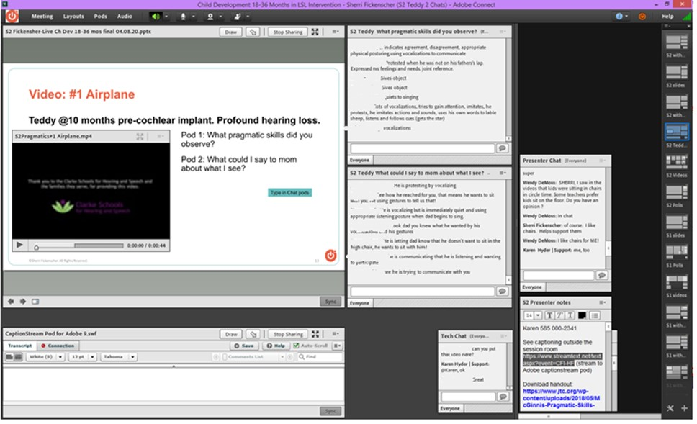
Presenter Only Area
Presenter Only Area (hidden from Participants)
Notes:
Sherri Fickenscher, M.S., LSLS Cert. AVEd Teacher of the Deaf Education Support Specialist
Clarke Schools for Hearing & Speech

Slide 30
Layouts and Presenter only area
What Layouts might you create?
Type in Chat
What pods might you put in the POA?
Type in Chat

Slide 31
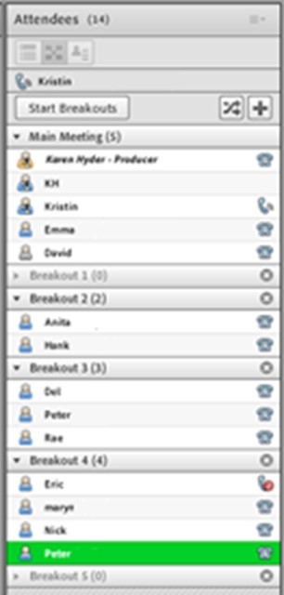
Using Breakouts
Create and setup breakout rooms
Customize with Share and Chat pods. Add instructions to Notes pods.
Move names into sub groups
Click Start button
Visit session rooms
Send Broadcast messages
Click End
All telephone audio lines must be merged with Attendee logins first!
More info. https://helpx.adobe.com/adobe-connect/using/breakout-rooms.html

Slide 33
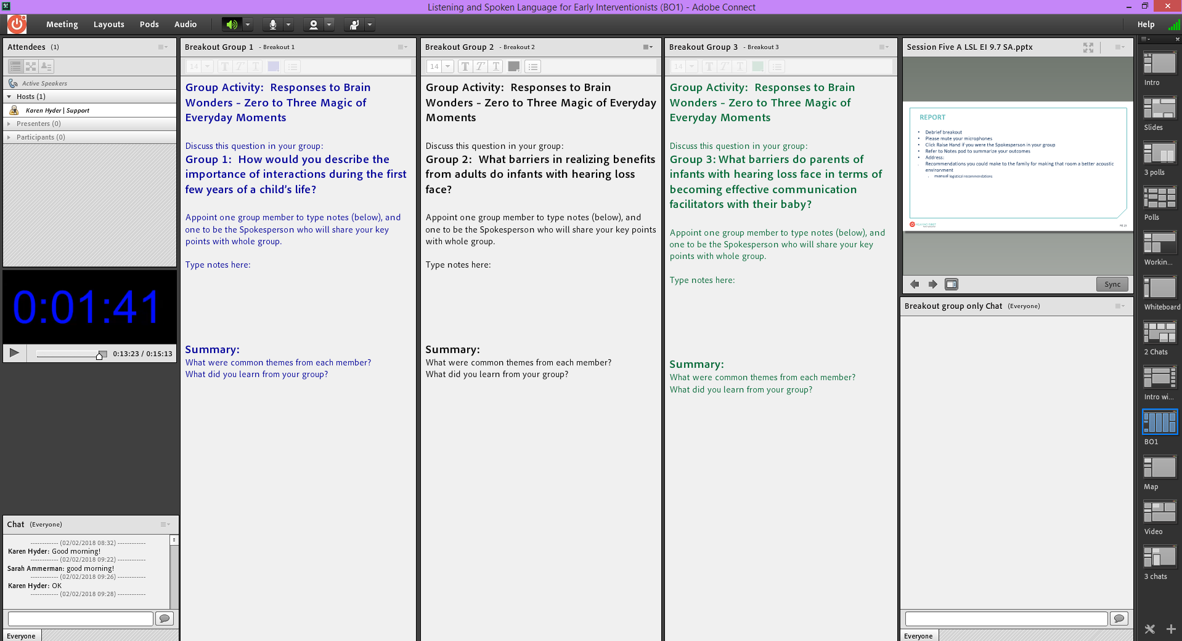

Slide 34
AC links
Adobe Connect Self test (send to participants with login details) https://[yourdomain].adobeconnect.com/common/help/en/support/meeting_test.htm
Adobe Connect system status https://status.adobe.com/products/3011
Find free and licensable apps to load into pods https://www.adobe.com/products/adobeconnect/apps.html
Pro tip: Add /?proto=true to force open AC app rather than browser.

Slide 35
Event time announcer
https://www.timeanddate.com/worldclock/fixedtime.html?msg=IABL+115%3A+Leveraging+Adobe+Connect+for+Successful+Blended+Learning%3A+A+Case+Study&iso=20200422T21&p1=179&am=45
Shortened by Bit.ly https://bit.ly/3bAkzgh
Bit.ly
https://bitly.com/

Slide 36
Things we wish we had known before we started
Participants need to unlearn habits and commit to this new model.
Participants are inexperienced with technology, using array of devices and from every location. Many on WiFi. Very few use headsets. Not interested in Orientation sessions.
Breakout rooms unnecessary for learning outcomes.
Motivate extrinsically with CEU requirements!
Offer technical tutorial before each live session. Tech Chat pod to assist during live session.
Use robust video scenarios combined with chat and poll interactions.
Notes:
Corporate audiences have fiber connections and $100 headsets. Most of my facilitators and participants are at home, after work hours, using family resources. I have to remind them to not them the kids play video games online DURING their presentation if network throughput is inconsistent.

Slide 37
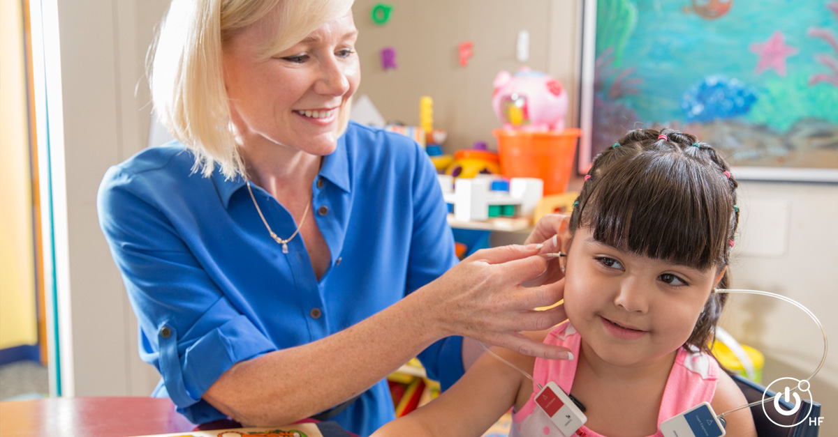
Since Fall 2016
Over 50 live learning experience programs
9,454 registrations
Attendees from 66 countries
4,640 total CEUs distributed
Notes:
Wendy

Slide 38
Learner feedback
“I see how effective viewing videos of real sessions is to the learning experience - it gives a more understandable picture of how to do it, rather than just reading about it or being told how to do it. I feel, after seeing clinician-parent interactions in real sessions, that I could emulate the clinician in my own sessions.”
“I think the research that was shared was extremely insightful, and really practical for my practice. Knowing what is best practice and having data to back it up, was extremely effective about this experience.”
“It's amazing to me that these courses are free and so accessible even from other countries. I truly wish I had the time to take every course! The length of time (4 weeks/10 hours) was perfect; the pre-learning was so helpful, the polls/questions kept us engaged and I’m never uncomfortable giving an answer even if it was wrong.”
“I really enjoyed this learning experience as a parent of a child with cochlear implants. I did not know much about the anatomy of the ear and was impressed with how detailed the information provided was. The research provided for the importance of early intervention was fascinating. I also enjoyed learning more about how hearing aids and cochlear implants work to provide sound to the individual.”
© Hearing First, LLC. ALL RIGHTS RESERVED.

Slide 39
What takeaways will share and/or apply immediately?
Type in Chat

Slide 40
I’m here.
Email: karen@karenhyder.com
www.linkedin.com/in/karenhyder
Twitter: @karenhyder
Blog: https://karenhyderblog.wordpress.com/
Site: www.karenhyder.com

